Slide 1
JAVA Programming (CSE181404)
Credit : 4
L - T – P : 2 - 0 - 4

Slide 2
JAVA
Developed by James Gosling and Patrick Naughton in 1991
Released by Sun Microsystems in 1995, later acquired by Oracle Corporation
Simple, object-oriented, secure and reliable programming language
Writing, compiling and debugging a program is easy
Helps to create modular programs and reusable code

Slide 3
Uses : JAVA is everywhere
More than 3 billion devices run Java
Examples:
Mobile applications (specially Android apps)
Desktop applications
Web applications
Web servers and application servers
Games
Database connection etc.

Slide 4
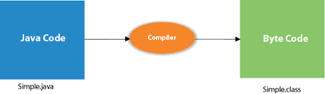
Some of the main features of Java
Simple
Syntax is quite simple, clean and easy to understand
Concepts like Pointers, Operator Overloading etc. are not there in JAVA
Platform Independent
On compilation, Java program is compiled into bytecode
This bytecode Can be run on any machine with Java Runtime Environment (JRE)
Portable
Java Byte code can be carried to any platform

Slide 5
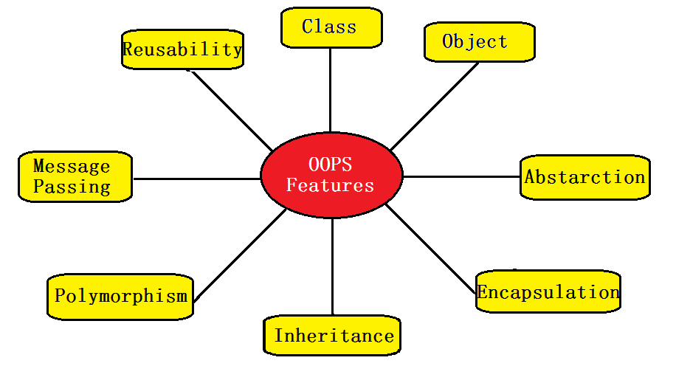
Some of the main features of Java (contd.)
Object-Oriented
Everything is Object which has some data and behaviour
Multi-threaded
Makes it possible to write program that can do many tasks simultaneously

Slide 6
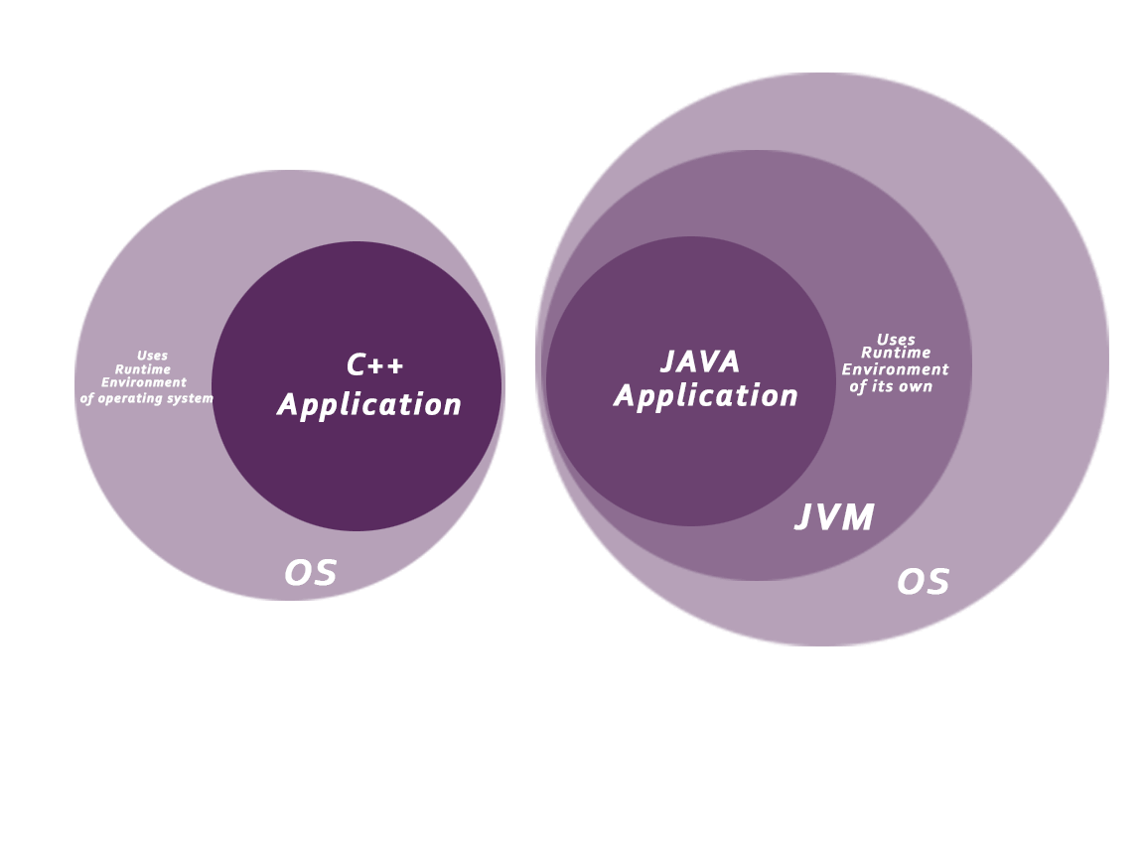
Some of the main features of Java (contd.)
Secured
JAVA enable us to develop virus free, temper free system
JAVA program always runs in Java runtime environment (JRE)
With almost null interaction with system OS, hence it is more secure
Java Runtime Environment
Provide an environment at runtime
Contains a set of supporting libraries including core classes and various other files that are used by JVM at runtime

Slide 7

Some of the main features of Java (contd.)
Robust
Java improved areas of Memory Management and mishandled Exceptions
By introducing automatic Garbage Collector and Exception Handling mechanisms
Distributed
Java is designed for the distributed environment of the internet
Java can create distributed applications using
Remote Method Invocation (RMI)
Enterprise Java Bean (EJB)

Slide 8
Writing, Compiling and Executing a JAVA program
Involves three steps
Writing the code and save it in a file with
Name same as the class name along with “.java” extension
Compiling the code in the source file (javac compiler)
Generates a machine independent encoding known as bytecode
The bytecode of the content of each class contained in the source file is
Stored in a separate “.class” file
Allows them to be run on any system

Slide 9
Writing, Compiling and Executing a JAVA program (contd.)
Executing the code
Goes through three stages before the final machine code is executed
Class Loader
- The main class is loaded into the memory by passing its ‘.class’
file to the JVM. Similarly, All the other classes referenced in
the program are loaded through the class loader
Bytecode Verifier
Checks that the instructions don’t perform damaging actions
Just-In-Time (JIT) Compiler
Help in making the execution process fast and efficient
- Finally, the interpreter (Java interpreter)
- Converts the loaded bytecode into machine code

Slide 10
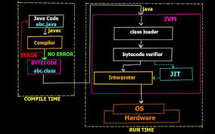
Writing, Compiling and Executing a JAVA program (contd.)

Slide 11
Writing a JAVA program
Writing
// Program to display a message
import java.io.*;
public class HelloWorld
{
public static void main(String[] args)
{
System.out.println(“This is my first java program");
}
}
Saving
>> HelloWorld.java

Slide 12
Compiling and Executing a JAVA program
Compiling
>> javac HelloWorld.java
Executing
>> java HelloWorld
Output
>> This is my first java program

Slide 13
Data Types
Data types in JAVA are divided into two groups
Primitive data types
Non-primitive data types
String, Arrays and Classes etc.
Data Type | Size | Description
byte | 1 byte | Stores whole numbers from -128 to 127
short | 2 bytes | Stores whole numbers from -32,768 to 32,767
int | 4 bytes | Stores whole numbers from -2,147,483,648 to 2,147,483,647
long | 8 bytes | Stores whole numbers from -9,223,372,036,854,775,808 to 9,223,372,036,854,775,807
float | 4 bytes | Stores fractional numbers upto 6 to 7 decimal digits
double | 8 bytes | Stores fractional numbers upto15 decimal digits
boolean | 1 bit | Stores true or false values
char | 2 bytes | Stores a single character /letter or ASCII values

Slide 14
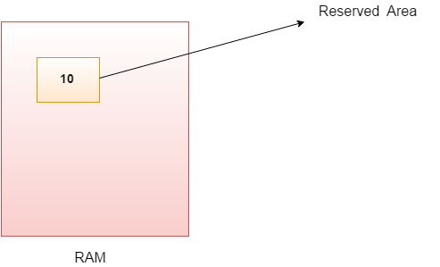
Variables
Variable is name of reserved area allocated in memory
A name of memory location
A combination of "vary + able" that means its value can be changed
There are three types of variables in Java
Local variable
Instance variable
Static variable

Slide 15
Variables (contd.)
Local Variable
A variable declared inside the body of the method
Can be used within that method only
Other methods in the class aren't even aware that the variable exists
Instance Variable
A variable declared inside the class but outside the body of any method
Called instance variable because its value is instance specific and is not shared among instances
Static variable
A variable which is declared as ‘static’
A single copy of static variable is created and share among all the instances of the class
Memory allocation for static variable happens only once
when the class is loaded in the memory

Slide 16
Variables (contd.)
Example
class A
{
int data=50; //instance variable
static int m=100; //static variable
void method()
{
int n=90; //local variable
}
}

Slide 17
Keywords
Keywords are particular words which acts as a key to a code
Some main keywords
abstract: Used to declare abstract class. Abstract class can provide the implementation of interface. It can have abstract and non-abstract methods.
Boolean: Used to declare a variable as a boolean type. It can hold True and False values only
break: Used to break loop or switch statement. It breaks the current flow of the program at specified condition
byte: Used to declare a variable that can hold an 8-bit data values
case: Used to with the switch statements to mark blocks of text
catch: Used to catch the exceptions generated by try statements. It must be used after the try block only
char: Used to declare a variable that can hold unsigned 16-bit Unicode characters
class: Used to declare a class
continue: Used to continue the loop. It continues the current flow of the program and skips the remaining code at the specified condition

Slide 18
Keywords (contd.)
default: Used to specify the default block of code in a switch statement
do: Used in control statement to declare a loop. It can iterate a part of the program several times
double: Used to declare a variable that can hold a 64-bit floating-point numbers
else: Used to indicate the alternative branches in an if statement
enum: Used to define a fixed set of constants. Enum constructors are always private or default
extends: Used to indicate that a class is derived from another class or interface
final: Used to indicate that a variable holds a constant value. It is applied with a variable. It is used to restrict the user
finally: Used to indicates a block of code in a try-catch structure. This block is always executed whether exception is handled or not

Slide 19
Keywords (contd.)
float: Used to declare a variable that can hold a 32-bit floating-point number.
for: Used to start a for loop. It is used to execute a set of instructions/functions repeatedly when some conditions become true. If the number of iteration is fixed, it is recommended to use for loop.
if: Used to tests the condition. It executes the if block if condition is true.
implements: Used to implement an interface.
import: Used to makes classes and interfaces available and accessible to the current source code.
instanceof: Used to test whether the object is an instance of the specified class or implements an interface.
int: Used to declare a variable that can hold a 32-bit signed integer.
interface: Used to declare an interface. It can have only abstract methods.
long: Java long keyword is used to declare a variable that can hold a 64-bit integer.
native: Java native keyword is used to specify that a method is implemented in native code using JNI (Java Native Interface).
new: Java new keyword is used to create new objects.

Slide 20
Keywords (contd.)
null: Java null keyword is used to indicate that a reference does not refer to anything. It removes the garbage value.
package: Java package keyword is used to declare a Java package that includes the classes.
private: Java private keyword is an access modifier. It is used to indicate that a method or variable may be accessed only in the class in which it is declared.
protected: Java protected keyword is an access modifier. It can be accessible within package and outside the package but through inheritance only. It can't be applied on the class.
public: Java public keyword is an access modifier. It is used to indicate that an item is accessible anywhere. It has the widest scope among all other modifiers.
return: Java return keyword is used to return from a method when its execution is complete.
short: Java short keyword is used to declare a variable that can hold a 16-bit integer.

Slide 21
Keywords (contd.)
static: Java static keyword is used to indicate that a variable or method is a class method. The static keyword in Java is used for memory management mainly.
strictfp: Java strictfp is used to restrict the floating-point calculations to ensure portability.
super: Java super keyword is a reference variable that is used to refer parent class object. It can be used to invoke immediate parent class method.
switch: The Java switch keyword contains a switch statement that executes code based on test value. The switch statement tests the equality of a variable against multiple values.
synchronized: Java synchronized keyword is used to specify the critical sections or methods in multithreaded code.
this: Java this keyword can be used to refer the current object in a method or constructor.
throw: The Java throw keyword is used to explicitly throw an exception. The throw keyword is mainly used to throw custom exception. It is followed by an instance.

Slide 22
Keywords (contd.)
throws: The Java throws keyword is used to declare an exception. Checked exception can be propagated with throws.
transient: Java transient keyword is used in serialization. If you define any data member as transient, it will not be serialized.
try: Java try keyword is used to start a block of code that will be tested for exceptions. The try block must be followed by either catch or finally block.
void: Java void keyword is used to specify that a method does not have a return value.
volatile: Java volatile keyword is used to indicate that a variable may change asynchronously.
while: Java while keyword is used to start a while loop. This loop iterates a part of the program several times. If the number of iteration is not fixed, it is recommended to use while loop.

Slide 23
Operators
An operator is a symbol which is used to perform operations
Types of operators in Java
Unary Operators
Arithmetic Operators
Shift Operators
Relational Operators
Bitwise Operators
Logical Operators
Ternary Operators
Assignment Operators

Slide 24
Operators and Precedences
Operator Type | Category | Precedence
Unary | postfix | expr++ expr--
 | prefix | ++expr --expr +expr -expr
Arithmetic | multiplicative | * / %
 | additive | + -
Shift | shift | << >> >>>
Relational | comparison | < > <= >= instanceof
 | equality | == !=
Bitwise | bitwise AND | &
 | bitwise exclusive OR | ^
 | bitwise inclusive OR | |
Logical | logical AND | &&
 | logical OR | ||
Ternary | ternary | ? :
Assignment | assignment | = += -= *= /= %= &= ^= |= <<= >>= >>>=

Slide 25
Packages in JAVA
A package in Java is
Used to group of related classes, interfaces and other sub packages
Packages are of two types
Built-in Packages (Come as a part of JRE)
User-defined Packages (Defined by programmers to group related classes)
Advantages of using a package in Java
Java package is used to categorize the classes and interfaces so that
They can be easily located, maintained and used
Java package provides access protection
Java package helps to avoid name collision

Slide 26
Packages in JAVA (contd.)
Java provides a large numbers of classes
Grouped into different packages according to functionality
Some commonly used built-In packages are
java.io | Input/output support classes. They provide facilities for the input and output of data
java.lang | Language support classes which includes classes for primitive types, string, math functions, thread and exceptions
java.util | Language utility classes such as vectors, hash tables, random numbers etc.
java.applet | Classes for creating and implementing applets
java.net | Classes for networking. They include classes for communicating with local computers as well as with internet servers
java.awt | Set of classes for implementing graphical user interface. They include classes for windows, buttons, lists, menus and so on

Slide 27
Control Statements
Control Statements
Allows the smooth flow of a program
Used to control the flow of execution of program based on certain conditions
Control statements in JAVA
Decision Making Statements
Simple if statement | if-else statement | nested if statement
switch statement
Looping statements
while loop | for loop | do-while loop
for each loop
Branching statements
continue | break | return

Slide 28
Classes & Objects
Class
A user defined blueprint or prototype from which objects are created
It is a logical entity and can't be physical
Represents the set of properties or methods
Common to all objects of one type
Object
A basic unit of Object Oriented Programming and represents the real-world entities
An object has
State : Represents the properties of an object
Behaviour : Represented by methods of an object
Identity : A unique name to an object

Slide 29
Declaring a Class
Syntax to declare a class
Access Modifier class <class_name>
{
fields;
methods;
}

Slide 30
Creating an Object
There are several ways to create objects in JAVA
Using new keyword
It is the most common and general way to create object in java.
Example:
Test t = new Test();
Using Class.forName(String className) method
There is a pre-defined class in java.lang package with name Class.
Example: Suppose we want to creating object of class Test in com.p1 package Test obj = (Test) Class.forName("com.p1.Test").newInstance();
Using clone() method:
clone() method is present in Object class. It creates and returns a copy of the object.
Example:
Test t1 = new Test(); // creating object of class Test
Test t2 = (Test) t1.clone(); // creating clone of above object
Deserialization method:
De-serialization is technique of reading an object from the saved state in a file
FileInputStream file = new FileInputStream(filename);
ObjectInputStream in = new ObjectInputStream(file);
Object obj = in.readObject();

Slide 31
Access Modifiers
An access modifier are used to restrict the access of a class, data member and method in another class
In JAVA, there are four access modifiers
public
Classes, methods or data members, declared as public, are accessible from every where in the program
private
Classes, methods or data members, declared as private, are accessible only within the class in which they are declared
protected
Classes, methods or data members, declared as protected, are accessible within same package or sub classes in different package
default
When no access modifier is specified for a class , method or data member
Have the default access modifier by default accessible only within the same package

Slide 32
Week 1: To do
Write a program calculate simple interest
Write a program calculate compound interest
Write a program to generate the Fibonacci series within a range using for loop
Write a program compute and print all the prime numbers within a range using while loop
Write a program to develop a simple calculator using switch statement and do while loop

Slide 33
Constructors in JAVA
In JAVA
A constructor is
A block of code which can be used to initialize the fields of newly created
object
Often referred to as a special type of method
But there is a big difference between Constructors and Methods
In terms of purpose, syntax, and invocation

Slide 34
Constructors Vs Methods
 | Constructor | Method
Purpose | To create an instance of a Class Used to memory allocation and member initialization (Optional) | Cannot be used to create an instance of a Class Used to perform a task
Syntax | Cannot have Non Access Modifiers i.e., Constructors cannot be abstract, final, static and synchronised Cannot have a return type (Including void) Name must be the same as the Class name | Do not have any such restrictions
Invocation | Cannot be called explicitly Only called once implicitly when an instance of the class is created | Can be called explicitly Any numbers of time

Slide 35
Constructors in JAVA
Implementation of a constructor with a simple example program
public class Test
{
int x, y;
public Test()
{
x = 5;
y = 10;
}
public static void main( String args[] )
{
Test t1 = new Test();
System.out.println(“x = “ + x + “ y = “ + y);
}
}
Output:
x = 5 Y = 10

Slide 36
Types of Constructors
Three types of constructors
Default constructor
If no constructor is implemented for a class, Java compiler inserts a default constructor into that class on it’s behalf
The body of the constructor is empty
No-argument constructor
Constructor with no arguments
The signature is same as default constructor, however body can have some code unlike default constructor
Parameterized constructor
Constructor with arguments (or parameters)

Slide 37
Examples of Constructor
class Example1
{
int var = 5;
public void showValue()
{
System.out.println("var = "+ var);
}
public static void main( String args[] )
{
Example obj = new Example2();
obj.showValue();
}
}
Output:
var = 5

Slide 38
Examples of Constructor
class Example2
{
int var;
public Example2() //No-argument constructor
{
this.var = 10;
}
public Example2(int num) //parameterized constructor
{
this.var = num;
}
public void showValue()
{
System.out.println("var = "+ var);
}
public static void main( String args[] )
{
Example2 obj1 = new Example2();
obj1.showValue();
Example2 obj2 = new Example2(100);
obj2.showValue();
}
}
Output:
var = 10
var = 100

Slide 39
Copy Constructors in JAVA
In JAVA
There is no copy constructor
However, we can copy the values from one object to another
Like copy constructor in C++

Slide 40
Copy Constructors in JAVA
class Rectangle { int length; int breadth; Rectangle(int l, int b) //constructor to initialize length and bredth of rectang of rectangle { length = l; breadth= b; } Rectangle(Rectangle obj) //copy constructor { System.out.println("Copy Constructor Invoked"); length = obj.length; breadth= obj.breadth; } int area() //method to calcuate area of rectangle { return (length * breadth); } } class CopyConstructor //class to create Rectangle object and calculate area { public static void main(String[] args) { Rectangle firstRect = new Rectangle(5,6); Rectangle secondRect= new Rectangle(firstRect); System.out.println("Area of First Rectangle : "+ firstRect.area()); System .out.println("Area of First Second Rectangle : "+ secondRect.area()); } }

Slide 41
Inheritance
Inheritance
A process by which one class acquires the properties (data members) and functionalities (methods) of other class(s)
The aim of inheritance is
To provide the feature called reusability of code
So that a class has to write only the unique features and
Common properties and functionalities can be inherited from other class(s)
The class that inherits the properties and functionalities of other class(s) is
known as child class, sub class or derived class
The class whose properties and functionalities are inherited by another class is
known as parent class, super class or Base class

Slide 42
Inheritance
Syntax for implementing inhetance in JAVA
class Class_A
{
//methods and fields
}
class Class_B extends Class_A
{
//methods and fields
}

Slide 43
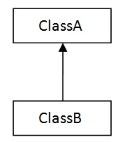
Single Inheritance
One class inherits
The features of another class
Example
class Animal
{
void eat()
{
System.out.println(“Eats...");
}
}
class Dog extends Animal
{
void bark()
{
System.out.println("barks...");
}
}
public class Single_Inheritance
{
public static void main(String args[])
{
Dog d = new Dog();
d.eat();
d.bark();
}
}

Slide 44
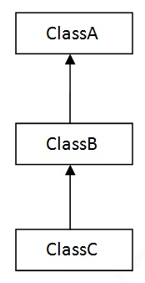
Multilevel Inheritance
One class inherits the features of the other classes level-wise
Example
class Shape
{
public void display()
{
System.out.println(“display");
}
}
class Rectangle extends Shape
{
public void area()
{
System.out.println(“area");
}
}
class Cube extends Rectangle
{
public void volume()
{
System.out.println(“volume");
}
}
public class Multilevel_Inheritance
{
public static void main(String[] args)
{
Cube cube = new Cube();
cube.display();
cube.area();
cube.volume();
}
}

Slide 45
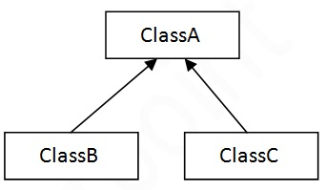
Hierarchical Inheritance
Hierarchical Inheritance
More than one class inherits the features of the same class
i.e., a parent class has two or more child classes
class Animal
{
void eat()
{
System.out.println("eating");
}
}
class Dog extends Animal
{
void bark()
{
System.out.println("barking");
}
}
class Cat extends Animal{
void meow()
{
System.out.println("meows");}
}
class Hierarchical_inheritance
{
public static void main(String a[])
{
Dog d=new Dog();
d.bark();
d.eat();
}
}

Slide 46
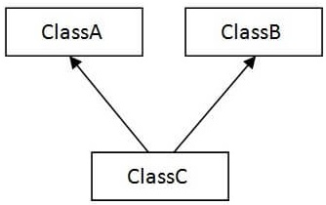
Multiple Inheritance
Multiple Inheritance
Where one class inherits the features of more than one class i.e., a child class has two or more parent classes

Slide 47
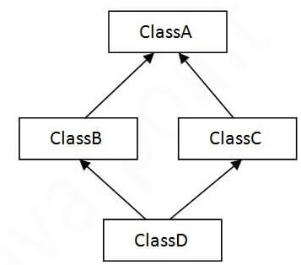
Hybrid Inheritance
Hybrid Inheritance
Combination of more than one types of inheritance

Slide 48
Interface
JAVA Interface is used to
Achieve abstraction
Support multiple inheritance
An interface in JAVA is
A blueprint of a class
Specify what a class must do and not how
Has static constants and abstract methods (only method signature, no body)
Methods must be implemented by the class
If a class implements an interface
Must provide bodies for all the method specified in the interface
Otherwise, the class must be declared abstract

Slide 49
Declaration of an Interface
An interface is declared by using the interface keyword
All the methods in an interface are declared with the empty body, and
All the fields are public, static and final by default
Syntax:
interface <interface_name>
{
// declare constant fields
// declare methods that abstract by default.
}

Slide 50
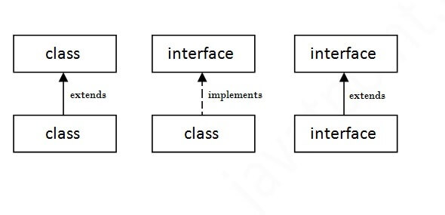
Relationship between Classes and Interfaces
The relationship between classes and interfaces

Slide 51
Example of Interface
interface printable
{
void print();
}
class Printer implements printable
{
public void print()
{
System.out.println ("Hello");
}
}
public static void main (String args[] )
{
Printer obj = new Printer ();
obj.print();
}
Output:
Hello

Slide 52
Multiple inheritance in Java by Interface
interface Printable
{
void print();
}
interface Showable
{
void show();
}
class Printer implements Printable, Showable
{
public void print()
{
System.out.println("Hello");
}
public void show()
{
System.out.println("Welcome");
}
public static void main(String args[])
{
Printer obj = new Printer();
obj.print();
obj.show();
}
}
Output:
Hello Welcome

Slide 53
Important points about Interface
Like abstract classes, interfaces cannot be used to create objects
Interface methods do not have a body - the body is provided by the class the implements the interface
On implementation of an interface, all of its methods must be Overridden
Interface methods are by default abstract and public
Interface attributes are by default public, static and final
An interface cannot contain a constructor
As it cannot be used to create objects
From Java version 9 onwards, interfaces can contain the following also:
Static methods
Private methods
Private Static methods

